Slide 1
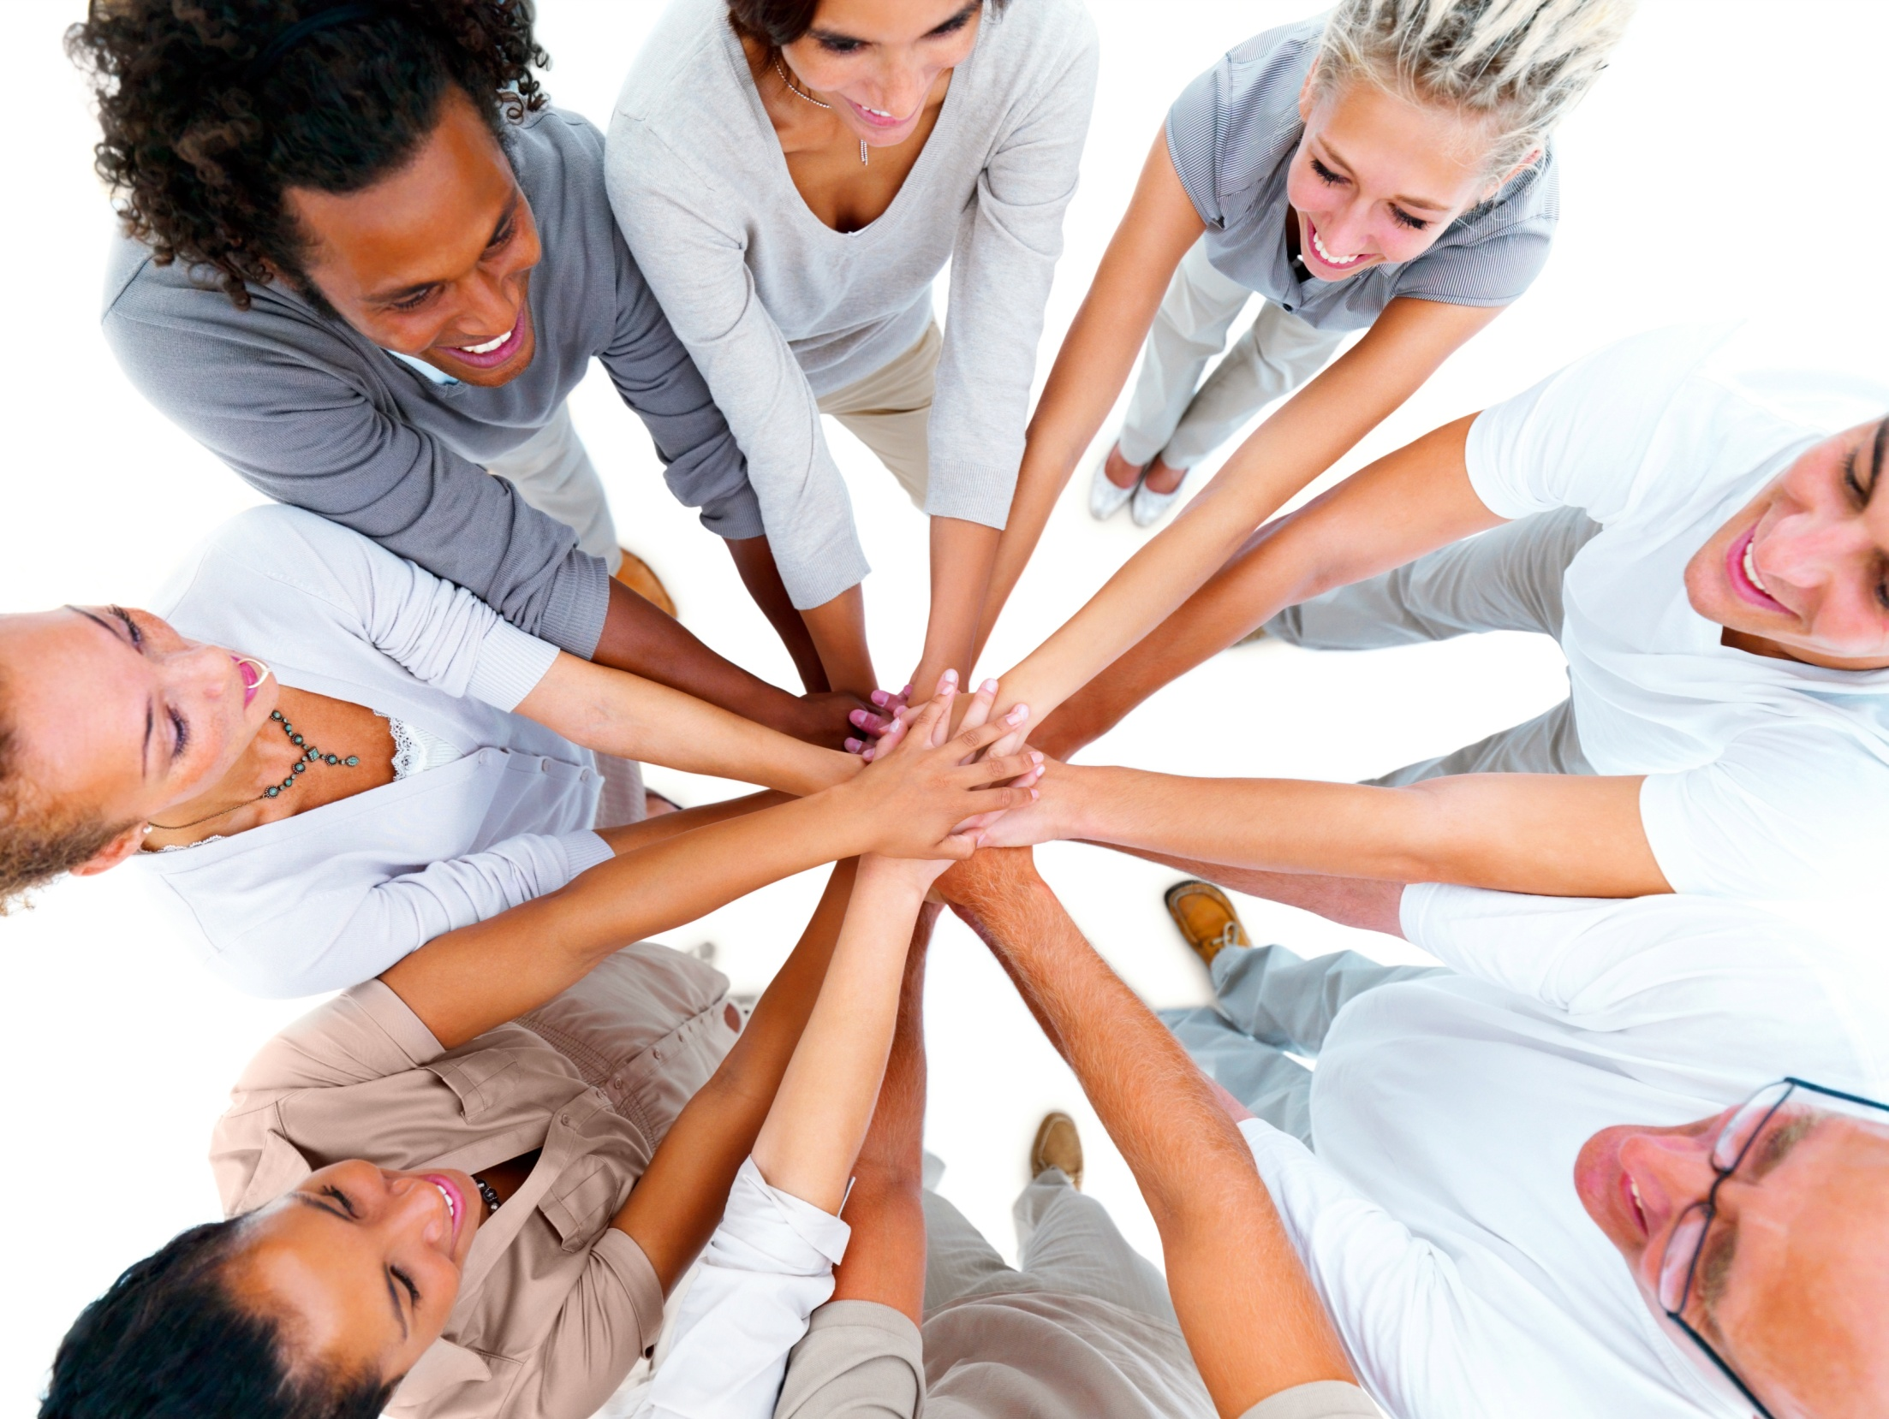
TOGETHER EVERYONE ACHIEVES MORE
The “Why” and “How” of Working in Teams

Slide 2
What is a team?
In simplest terms, a team is people working effectively together to achieve an agreed-upon goal.
Examples:-
1) Athletic Team
2) Buisness Team
Notes:
Note the important components of this simple definition: together, effectively, agreed-upon, and goal.
Example 1 is a link to a YouTube video of an advertisement for public transportation. In it, penguins work together to defeat a predator. Ask students to name the components of teamwork illustrated by the video.
Example 2 is a link to a YouTube video of the Pilobolus dance troupe. In it, members of the troupe work together to create amazing shadow images. Again, ask students to name the components of teamwork illustrated by the video.

Slide 3
Why Use Teams?
Benefits to the business, organization or system:
Enhanced creative thinking needed for innovation
Promote employee involvement and buy-in (commitment) to the company’s success
A team generates results that are greater than those that could be produced by its individual members
Notes:
Employee involvement leads to employee commitment to success of the project. (Emotional and intellectual investment in the success of the business and potentially greater employee job satisfaction and less employee turnover.)

Slide 4
Why Use Teams?
Benefits to the team member:
Improved professional and personal skills
Better understanding of the whole company/system and how it works
Preparation for upward professional growth (promotion)
Notes:
Team member = employee
Learning how to be an effective team member (and leader) allows employees to practice and demonstrate some of the skills needed for success in the workplace. There are very few jobs that allow employees to work individually with input only from a supervisor or client. On a personal level, communicating and negotiating with team members from other units in the company (or other academic disciplines) allows employees to practice not only their verbal communication skills but also listening and critical thinking.

Slide 5
Effective Team Characteristics
Team is not too big or small.
Members are competent in their team roles.
The team has a clear goal and all members are committed to accomplishing it.
Each member feels comfortable sharing his/her ideas.
Team members are willing to consider new ideas.
The team marks project milestones and assesses progress toward the goal.

Slide 6
External Support for the Team
Management supports and encourages the work of the team.
The team is provided with sufficient resources to accomplish the task or goal.
Team accomplishments are recognized.

Slide 7
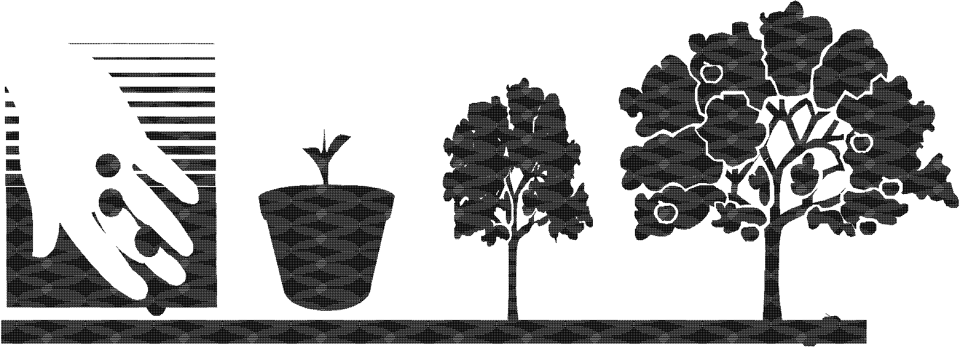
Stages of Team Development

Slide 8
Stages of Team Development
Forming
Storming
Norming
Performing
Transforming/Adjourning

Slide 9

Forming
 | Team members meet and introduce themselves.
 | A facilitator or leader is assigned or selected.
 | The team may set ground rules for the process.
 | Discussions about the project scope, goals, and timeframe begin.
 | The Forming stage includes polite but not deep conversation.

Slide 10

Storming
Members may compete for leadership of the group.
Conflicting ideas are expressed.
Some members speak little; others dominate the discussion.
Members argue about how to accomplish project goals and how to measure success.
The Storming stage is uncomfortable, but entirely normal.

Slide 11

Norming
Members reconcile differences.
Members now feel part of a productive group.
The team reaches agreement on goals and how to achieve them.
Information is freely shared.
During the Norming stage, teams begin to make significant progress.

Slide 12
Performing
Members understand their roles and trust one another to complete tasks.
Obstacles are easily overcome.
Productivity is high; each member contributes his/her skills and knowledge.
In the Performing stage, decision-making becomes easier because the group is truly functioning as a team.

Slide 13
Transforming/Adjourning
After goals are met, results evaluated and accomplishments acknowledged:
The team may be dismissed,
The team may be assigned a new project, or
Some members may leave the team and new members join for a new project.

Slide 14
MY TEAM IS NOT WORKING WELL TOGETHER!

Slide 15
Barriers to Team Performance
Conformity
Diffusion of responsibility (“not my job”)
Groupthink
Obedience to authority vs. empowered creativity
Lack of management support or resources
Notes:
Ask students how each of these barriers effects the potential team outcomes. Their answers may be something like the following: “Conformity means that the team will do what has always been done in the company. Nothing new will come out of the process.” “Diffusion of responsibility means that no one takes ownership for specific tasks needed to accomplish the team goals, so nothing gets done.” “Groupthink? Is that a bad thing?” [groupthink occurs when the team is so conflict-avoidant that the members don’t consider all possible solutions to a problem; harmony is more important than achieving the best outcome]
“Obedience to authority implies that team members are afraid to think outside the box, unlike empowered creativity.”
“If there is a lack of support, the team may have wonderful ideas that can never be carried out. This will lead to bad morale in the future and employees not wanting to serve on teams in the future.”

Slide 16
Diagnosis? Dysfunctional Team Behaviors
Members who:
Dominate every conversation
Withdraw from the process altogether
Act verbally or physically aggressive
Disagree every idea
Ignore the task at hand/perform unrelated tasks

Slide 17
Dysfunctional Behaviors Can Be Prevented
Recognize that group dynamics involve skills that must be learned; not everyone on a team may have mastered all of the skills required for successful teamwork.
Start by establishing—as a team—ground rules for operating the team.
Notes:
Instructors may need to lead students through a step-by-step process of team-building. Most students will have experienced group work; this does not mean that they possess good group interaction skills or attitudes or that they have been part of a successful team. Instructors should not assume that adult students already know how to work in teams. Group dynamics are a set of skills that cannot be taken for granted and must be taught.

Slide 18
What are Ground Rules?
Ground rules are written agreements among team members about how they will conduct themselves within the group.
Rules typically address how members will:
Behave toward one another
Make decisions
Solve problems
Prevent and manage conflict

Slide 19
Ground Rules Guidelines
The rules should be established by the whole team.
The team may modify the rules when necessary.
The team should review the rules when needed if group interaction appears to be deteriorating.
The team should decide what happens if a member does not follow the ground rules.

Slide 20
Creating Ground Rules
Build ground rules around behaviors that support:
Relationship-building
Task performance
Effective teamwork

Slide 21
Relationship-building
Behaviors that promote healthy team relationship-building include:
Open communication
Active listening
Encouraging one another
Resolving conflict
Acknowledging feelings
Setting and following standards

Slide 22
Effective Teamwork
Effectiveness is influenced by behaviors indicating positive attitudes toward the team and its work, such as:
Acknowledging a shared goal
Taking turns speaking and listening
Accepting feedback on ideas
Following the agreed-upon process
Reflecting on accomplishments

